Slide 1


Detecting Service Outages
MSA Project Week 2025
By: Bo Yang, Tyra Silaphet, Harita Patel, Navya Bingi

Slide 2



AGENDA
01
02
03
04
05
Data Objectives
Cleaning/EDA
K-Means
Random Forest
Model Summary

Slide 3


Dataset Objectives
Goal:
Differentiate between normal and abnormal customer behavior
1. IVR:
Understand why people are calling, products, exit points
2. Work orders:
Identifying anomalous work orders that could serve as early indicators of potential service disruptions
3. Outage Invocations:
Analyze user interactions, site activity, and time-based patterns

Slide 4

Data Cleaning
1. IVR
2. Work Orders
3. Outage Invocations
Categorized IVR Exit Point descriptions
Calculated duration of call in minutes
Removed outliers
One-hot encoding
Removed ID and NULL columns
Removed unnecessary and NULL columns
Calculated duration of work order in minutes
Extracted time-based features
One-hot encoding
Dropped rows with missing values
Removed unnecessary and NULL columns
Validated binary columns
Extracted time-based features
Standardized datetime conversions

Slide 5

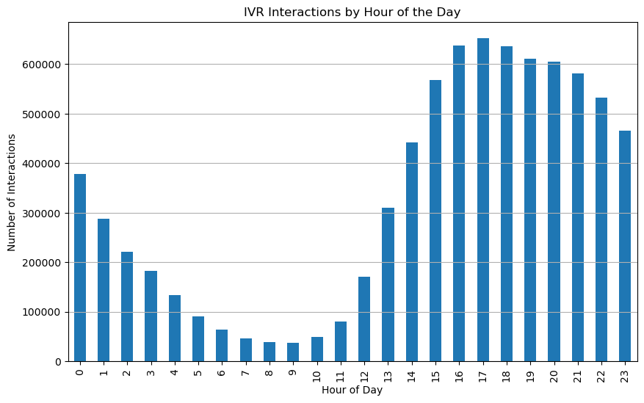
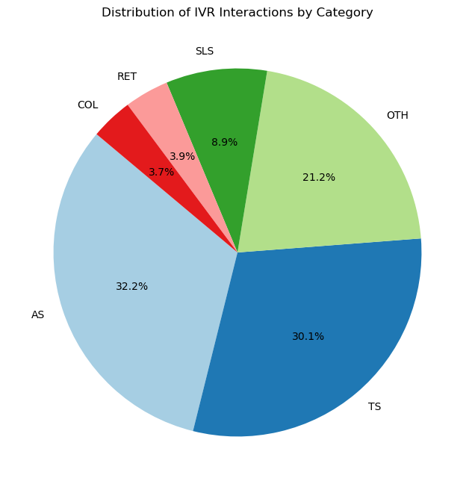
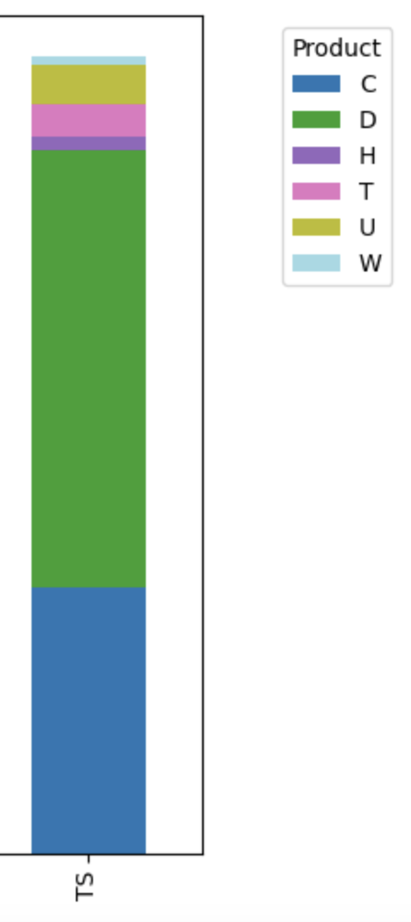
IVR Data Notable EDA
Narrowing it down…
5.7 MILLION
61 %
86 %
calls in the afternoon/evening
of these are technical support and account services calls
of technical support calls are about data and cable/video products
We are now left with 1.4 million high priority calls.

Slide 6
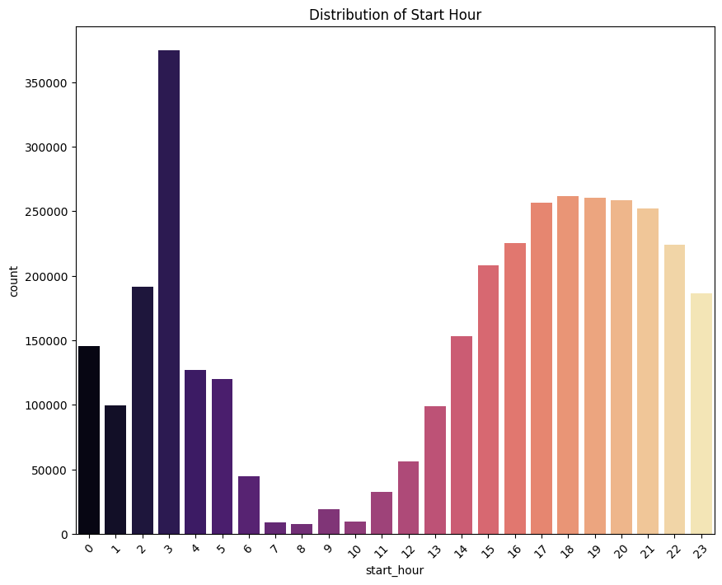
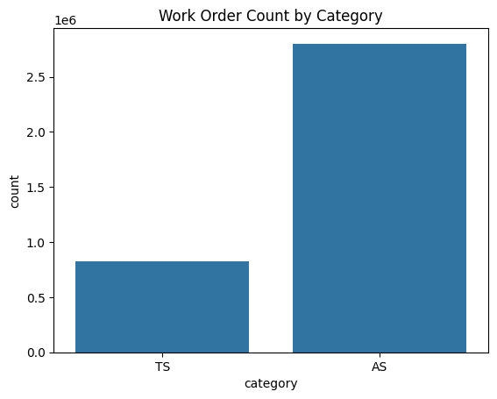
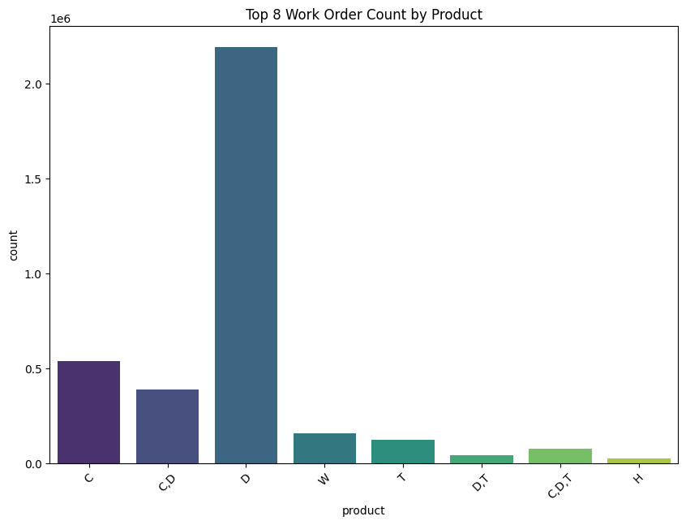
Work Order Data Notable EDA
When?
Category
Product
Work order times have a spike early morning and high occurrences afternoon-evening.
Technical support and account services are the most common work order types.
Work orders related to data products and cable/video products were most prevalent.

Slide 7
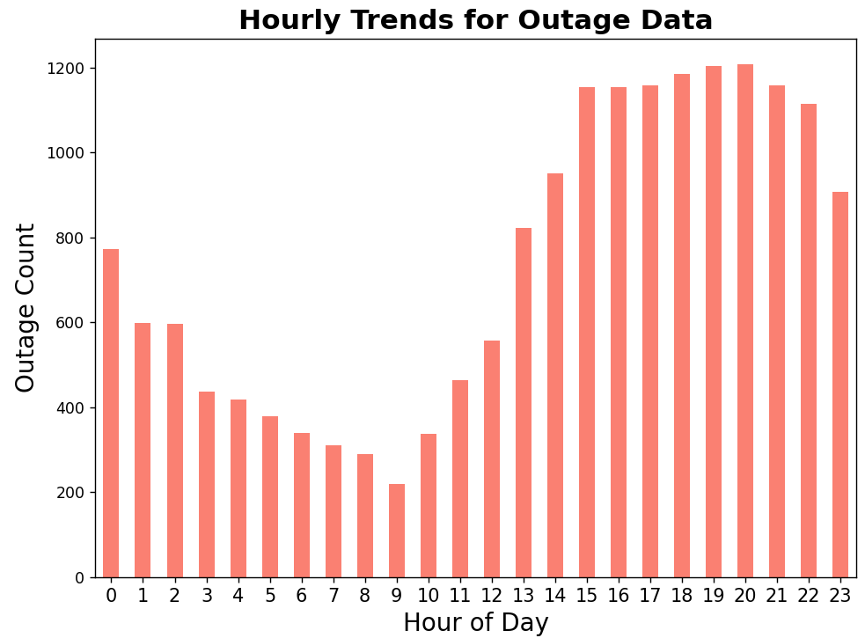
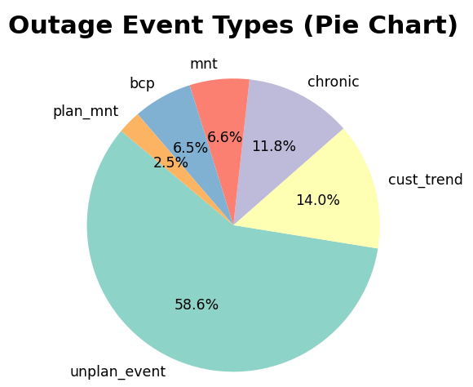
Outage Invocations EDA
When?
Event Type
Most outages occur in the afternoon - evening
Most outages are labeled as unplanned events.

Slide 8
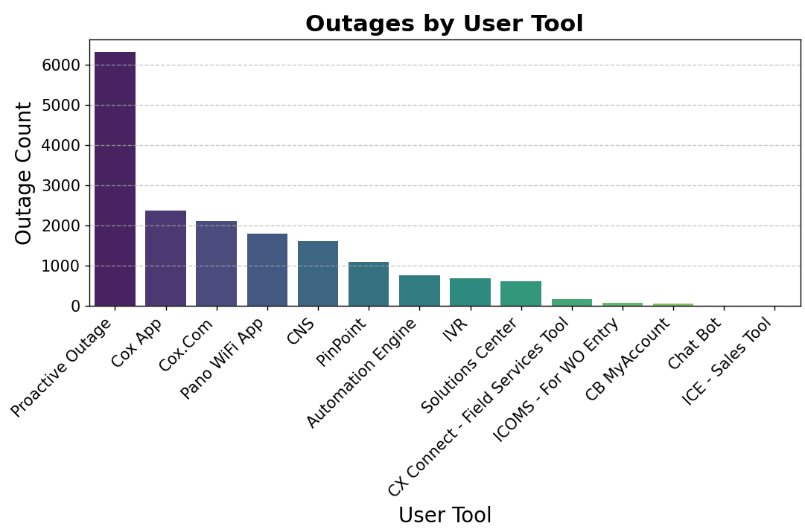
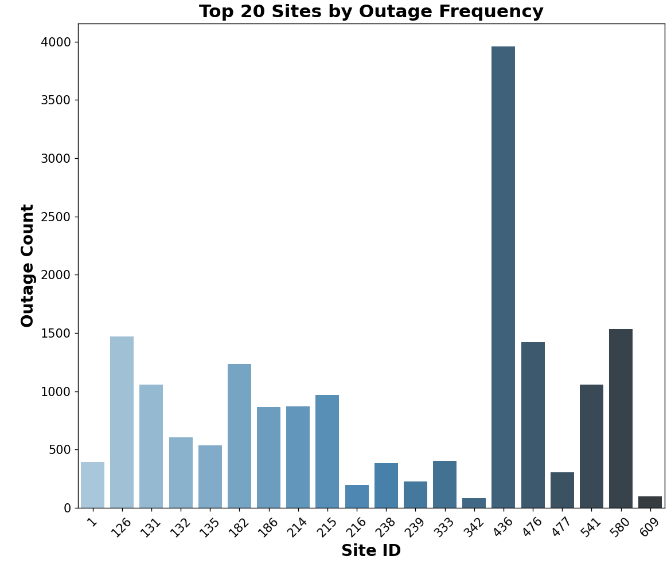
Outage Invocations EDA
User Tool
Where?
Most outages are reported using Cox App. Proactive outages are outbound comms.
Most outages are reported from site 436.

Slide 9



Model 1: K-Means

Slide 10
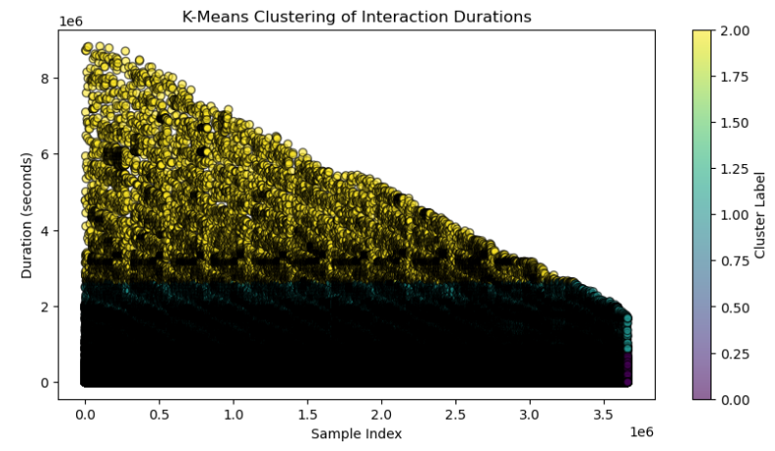
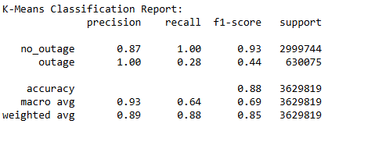
K-Means Clustering
Feature Engineering: create a new feature (duration)
Heuristic Labeling: classify interaction
Build models for Anomaly detection: K-Means ( clusters =2), CUSUM ( threshold = 2)
Recommendations:
Use additional work order features to improve the model
​
Collect and use more quantitative data for modeling​
​

Slide 11
Model 2: Random Forest

Slide 12

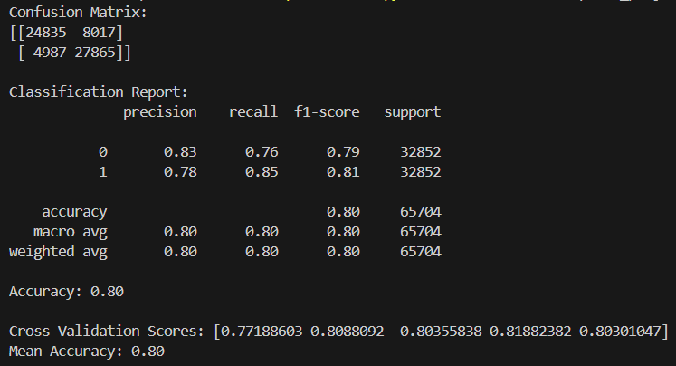
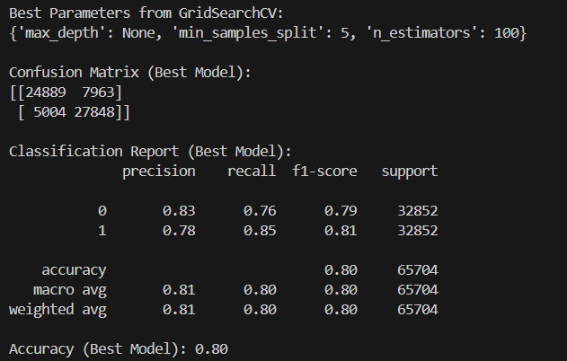

Random Forest Model
Feature Engineering: Incorporated temporal and user-tool-related features
User Tool Mapping: Enhanced interpretability by linking raw data to customer-facing channels
Hyperparameter Tuning: Leveraged GridSearchCV for optimal settings

Slide 13
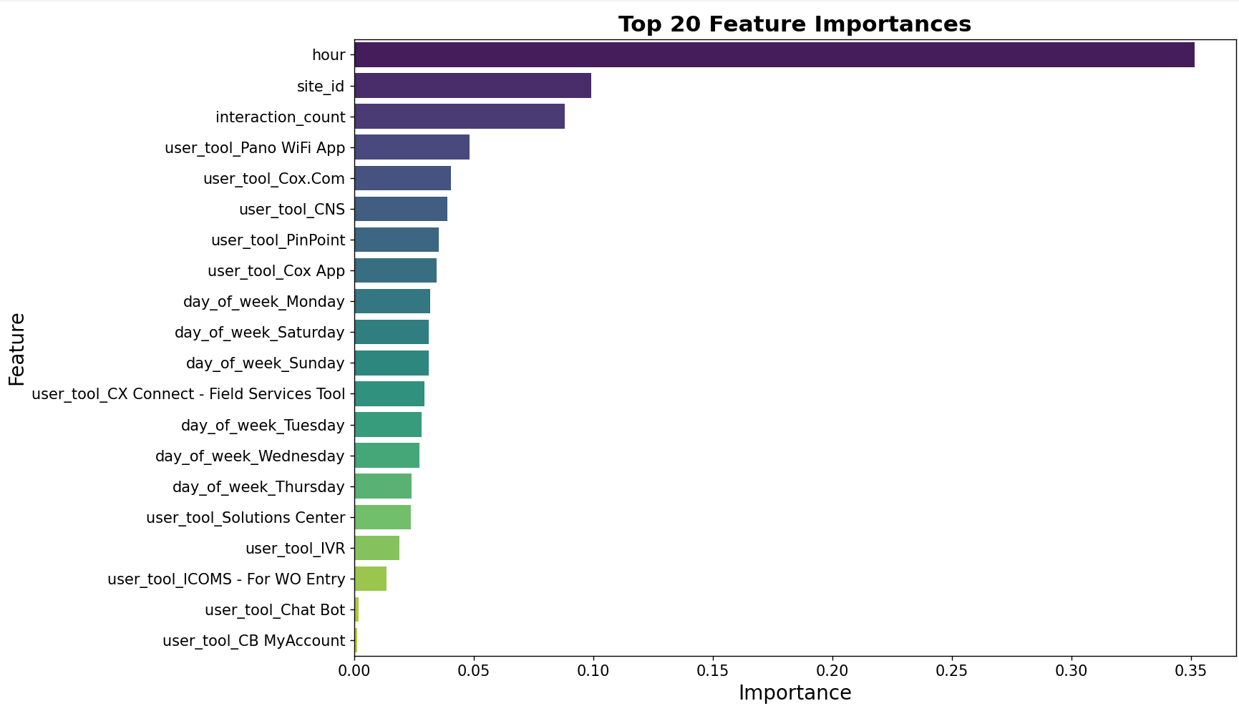
Recommendations
Optimize staff scheduling during peak outage hours to meet customer demand
Implement predictive maintenance for high-risk sites
Strengthen high-usage user tools for scalability and incorporate real-time outage alerts to manage customer interactions effectively

Slide 14
Model Summary
1. IVR Dataset:
2. Work orders:
3. Outage Invocations:
Created labels with: One class SVM
Created labels with: Isolation Forest
Grouped data using: K-means clustering
Modeled using: Logistic Regression
Created labels with:
Isolation Forest
Created labels with:
Z-Scores
Grouped data using:
K-means Clustering
Grouped data using:
CUSUM
Labeled data using: outage events
Optimized model using: GridSearchCV
Leveraged feature importance using: user tool mapping
Modeled using: Random Forest

Slide 15
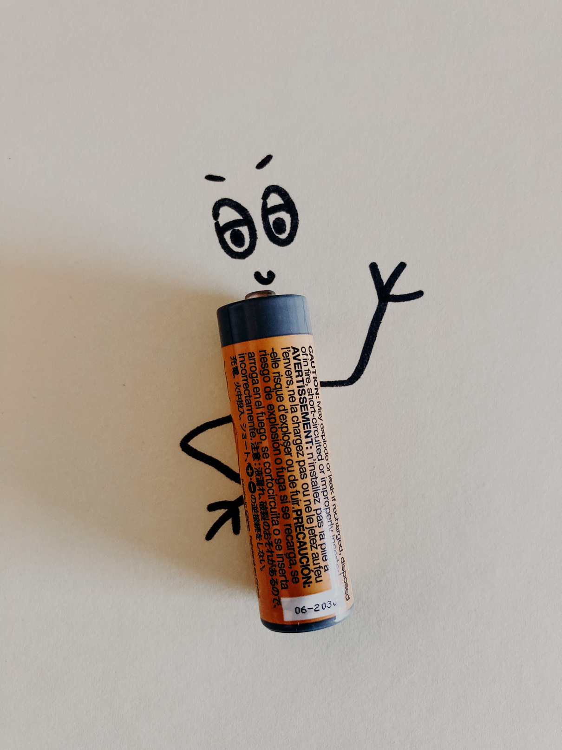


Questions?

